Slide 1
Unit 3A
Human Diversity & Change
Variation & evolution
Evolution

Slide 2

Study Guide
Read:
Chapters 15 & 16 in Human Perspectives. 7th edition.

Slide 3
Evolution
Evolution can be defined as:
the gradual process of change in the inherited traits of a population of organisms from one generation to the next.
or
A permanent change in a population’s gene pool from one generation to the next.

Slide 4
Evidence that supports evolution
Is there evidence: -
that things have changed over time?
of common ancestry?
of increasing complexity over time?

Slide 5
Evidence for evolution
Evidence for evolution can be obtained from
many sources. For example:
Fossils
Comparative anatomy
  Homologous structures
  Embryology
  Vestigial structures
Amino acid sequencing in proteins
Comparative studies of DNA

Slide 6
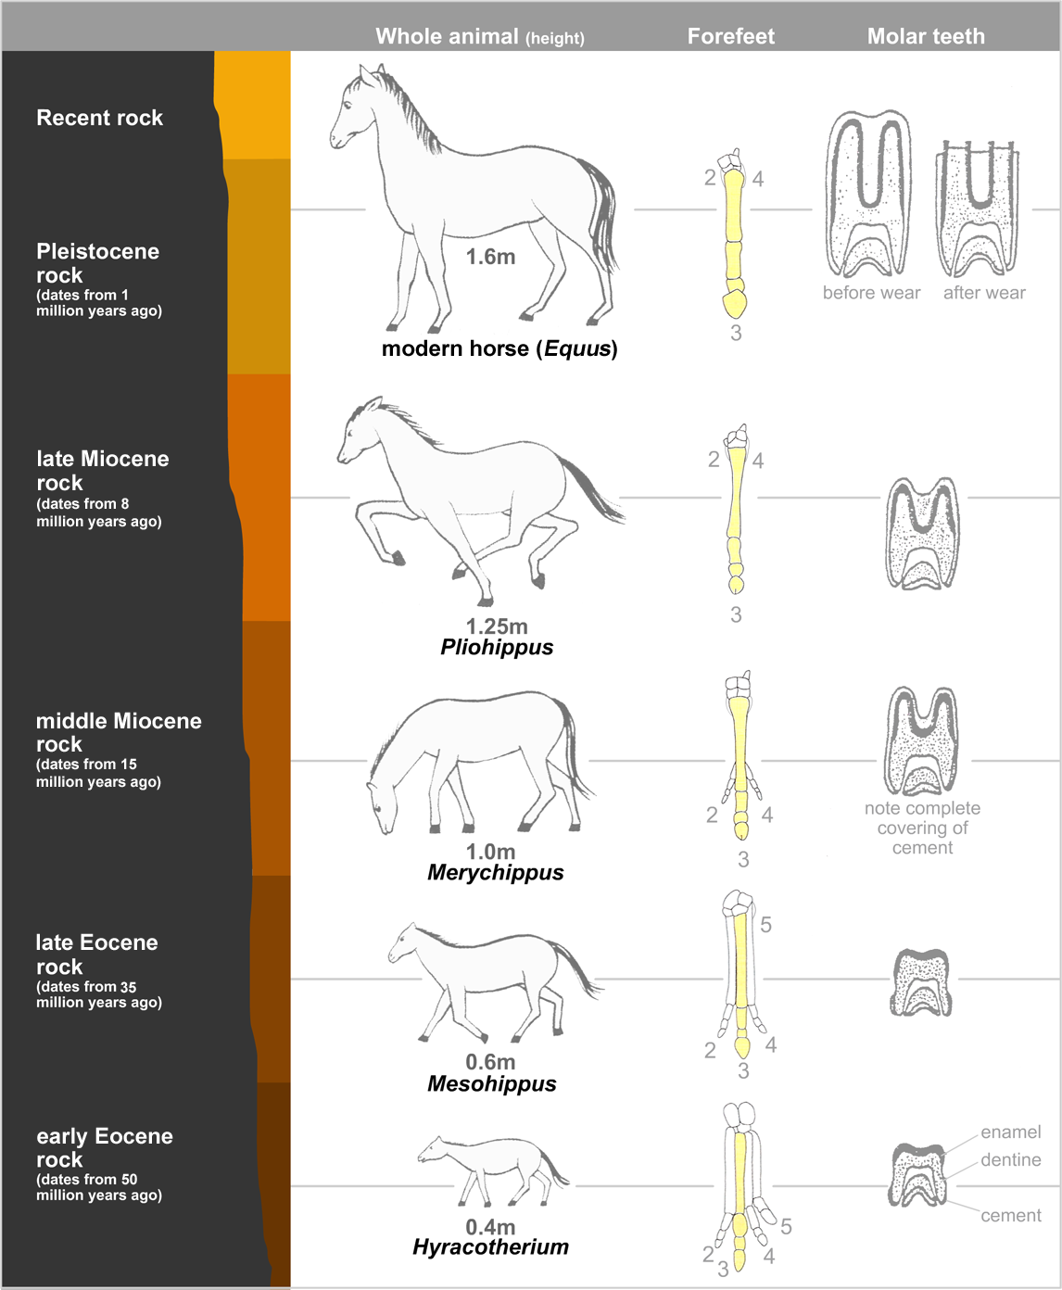
The fossil record
Organisms in the past were NOT the same as organism alive today e.g. the phylogeny of the horse.

Slide 7
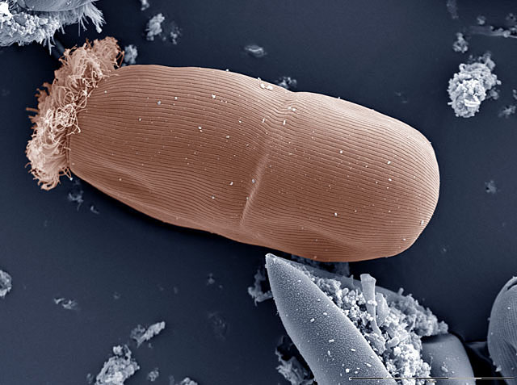
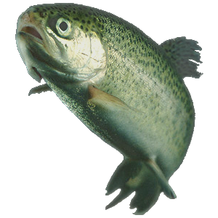
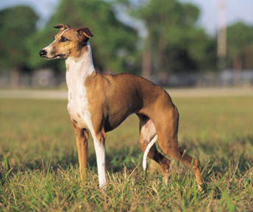
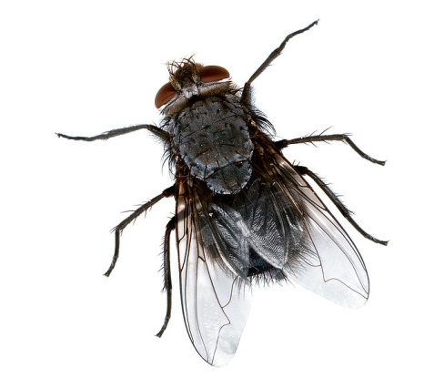
The fossil record - 2
Organisms have become more complex over time
e.g. protists→invertebrates→vertebrates.

Slide 8
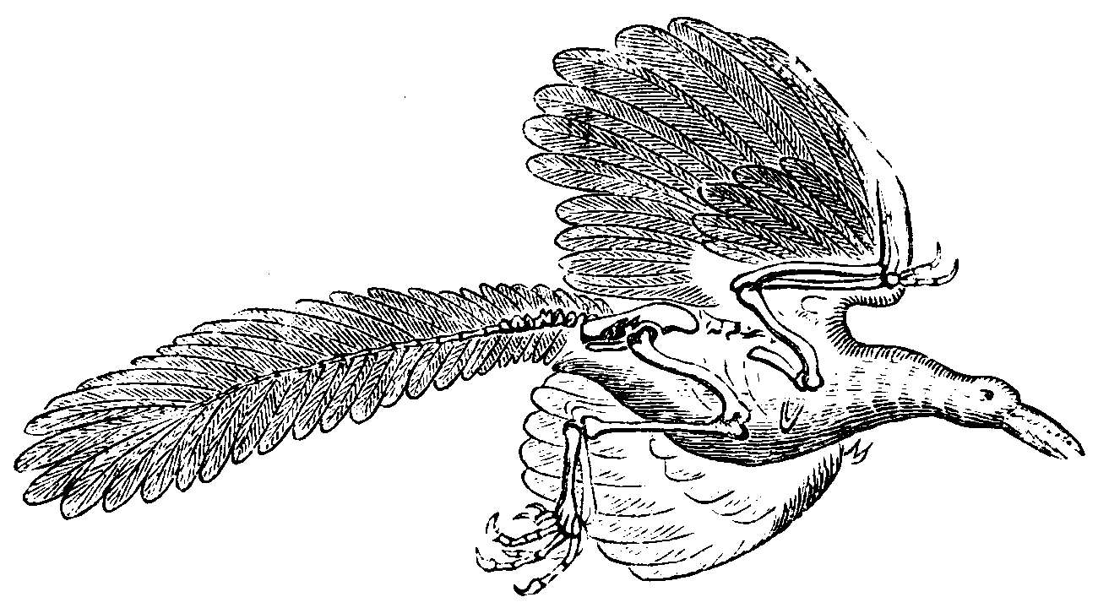
The fossil record - 3
Missing links – the common ancestors
e.g. Archaeopteryx.

Slide 9
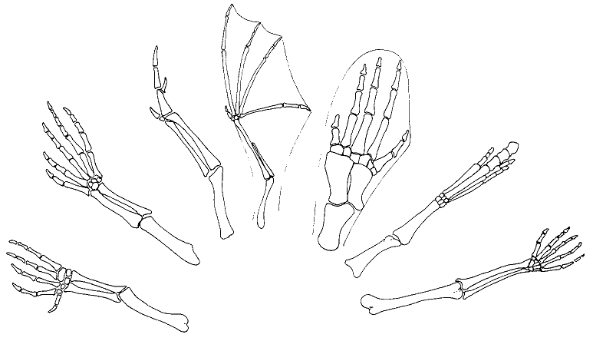
Homologous structures
Bat
Whale
Bird
Fossil horse
Crocodile
Lizard
Human
Structures with a similar architecture
e.g. pentadactyl limb in vertebrates
Similar structures but different functions?
Evidence of common ancestry

Slide 10
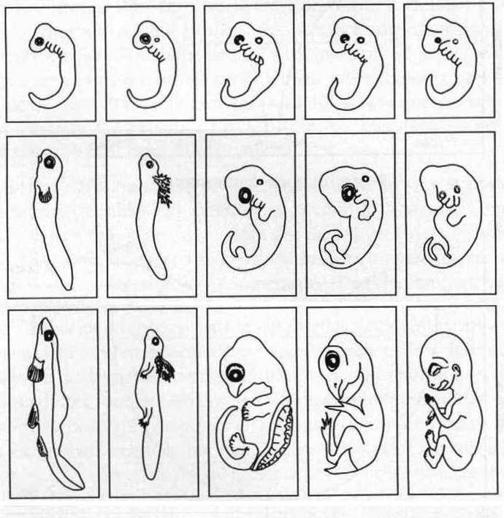
Comparative embryology
A
B
C
D
E
Many vertebrate embryos are similar.
Many have features not present in adult e.g. gills, tail.
Common developmental pathway depends on closeness of relationship.
These provide evidence of common ancestry.
A Fish; B Salamander; C Turtle; Chicken; E Human

Slide 11
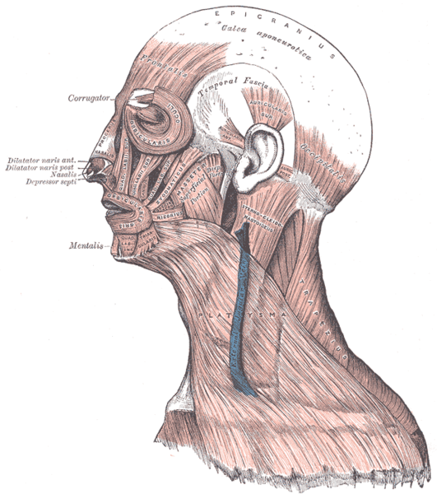
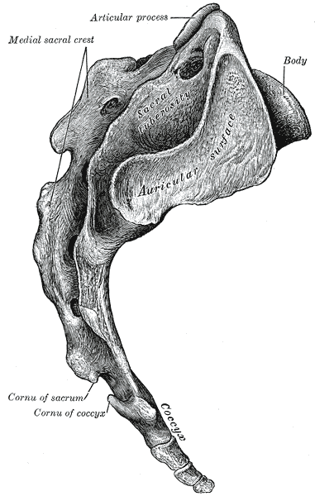
Vestigial structures
The coccyx is a vestigial tail
Vestigial muscles wiggle the ears
Vestigial structures:
are evolutionary leftovers e.g. coccyx, appendix
structures that no longer serve any purpose
are reduced in size to conserve energy.
provide evidence of change over time.

Slide 12
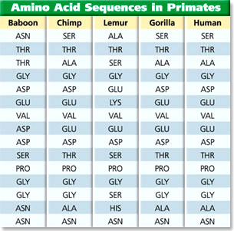
Amino acid sequencing
Proteins are made of long sequences of amino acids
Sequences are very similar in closely related species
Sequences less similar in more distantly related species
Indicates evolution from common ancestor

Slide 13
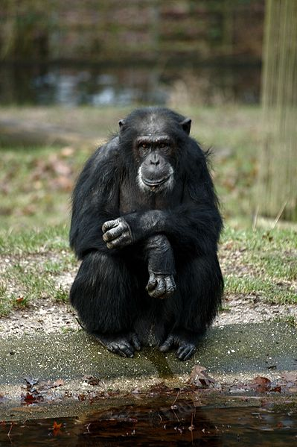
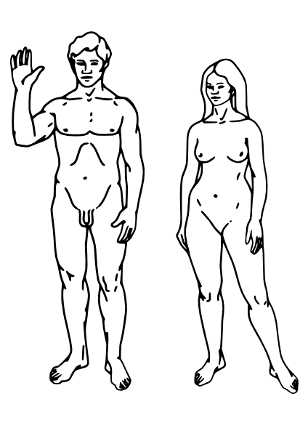
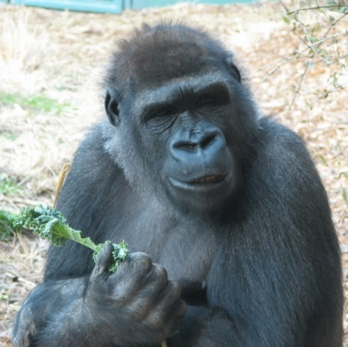
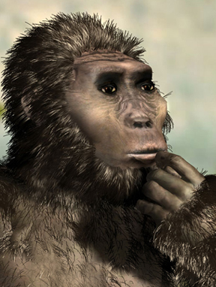
Comparative studies of DNA
DNA is made of long chains of nucleotides
Sequences of bases (A, T, C, G) are very similar in closely related species.
Sequences less similar in more distantly related species.
The similarity of the DNA indicates evolution from a common ancestor.

Slide 14
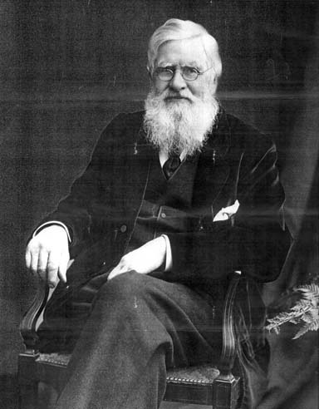
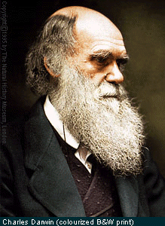
Natural selection
Alfred Wallace
Charles Darwin
Natural selection is the scientific theory proposed by Charles Darwin and Alfred Wallace that organisms best adapted to their environment tend to survive and out-multiply those that are less well adapted.

Slide 15
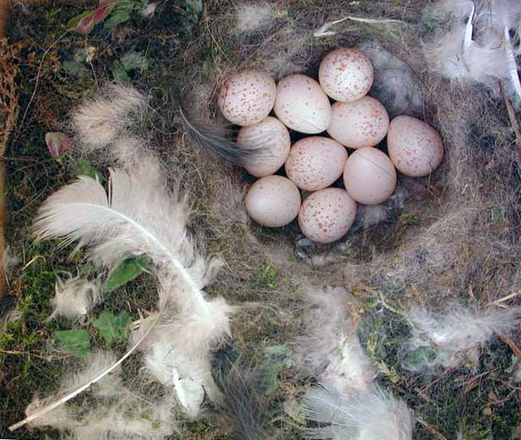
How natural selection works
Sylke Rohrlach
Overproduction – more young are born than survive to maturity.
Variation – sexually reproducing species
(e.g. humans) show variation in all inherited features.

Slide 16
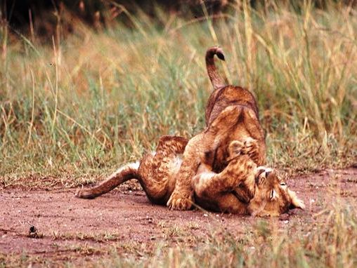
John Storr
3. Struggle for survival – individuals in a population compete with one another for survival
e.g. competition for resources, mates or against predators and disease.

Slide 17
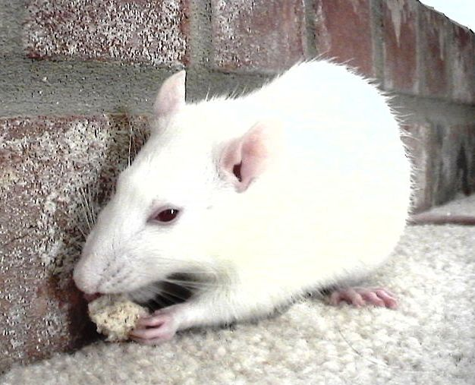
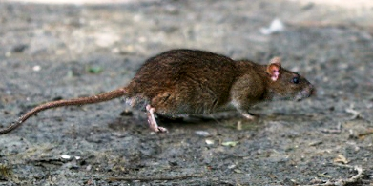
Adaptation – species have features that help them survive in their natural habitat.
Survival of the fittest (Herbert Spencer) –some individuals are better adapted to their environment and are more likely to survive than others.
Notes:
The brown rat looks a bit sick!

Slide 18
6. Reproductive fitness – those who survive longest are likely to successfully raise the most children.
7. Allele carryover – children who survive will carry the alleles that determine adaptive features.
8. Change to the gene pool (evolution) - alleles that determine favourable features will increase in gene pool whereas unfavourable alleles will decrease.

Slide 19
Micro and macroevolution
Microevolution describes the relatively small-scale evolutionary changes that take place within a species.
Macroevolution describes the evolutionary processes that result in large-scale changes and the formation of new taxonomic groups.

Slide 20
Speciation
Speciation describes the evolutionary processes that lead to the formation of a new species.
Speciation is a macro evolutionary process and can occur in several ways.

Slide 21
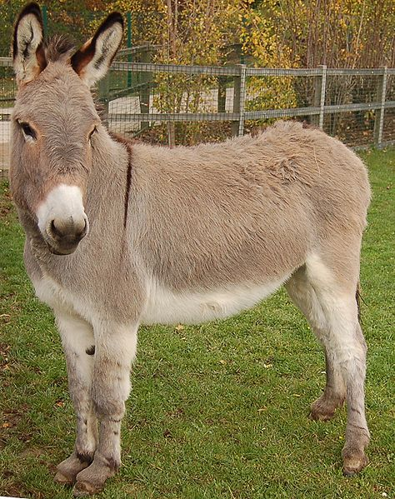
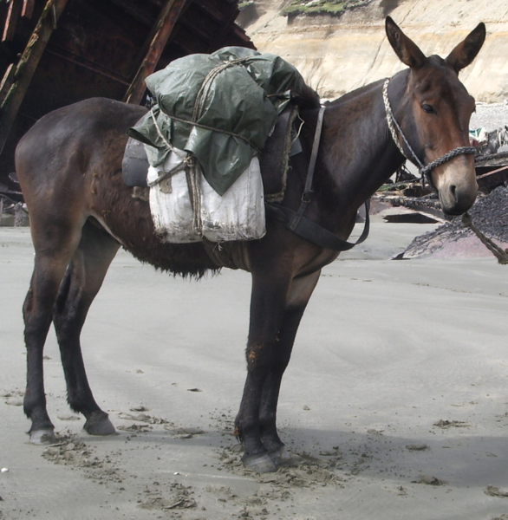
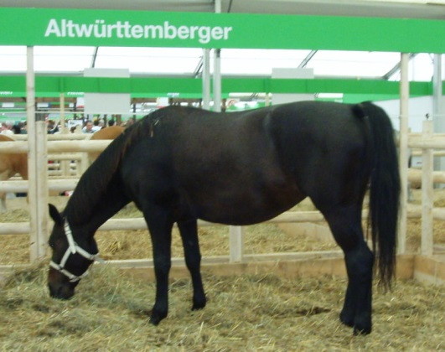
Species
Fertile donkey
Fertile horse
Infertile mule
A species can be defined in different ways.
A species is commonly defined as a group of organisms that are able to breed together to produce fertile offspring.
In other instances definitions of species are based on similarities in appearance, physiology, behaviour or genetics.

Slide 22
Step 1 - isolation
New population established adjacent to, or in isolation from the parent population
Sub-population formed within the parent population
Speciation can occur in several ways.
Isolation of a breeding population – this can either occur within the parent population (e.g. race or religion) or in isolation from the parent population (e.g. migration).
In both cases, interbreeding (gene flow) between the two populations is disrupted.

Slide 23
Step 2 - adaptation
As a result of natural selection, the sub-population adapts to its new environment.
If the sub-population is small, changes to its gene pool can be amplified by random events, such as founder effect and genetic drift.

Slide 24
Step 3 – reproductive isolation
Reproductive isolation occurs if the two populations become sufficiently different (structural, behavioural, physiological or genetic) that they can no longer interbreed, or produce fertile offspring.
If this occurs, the two populations will be regarded as different species.

Slide 25
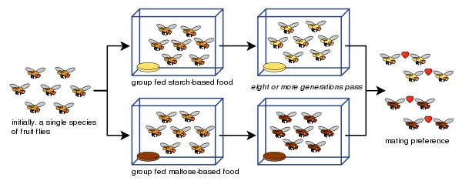
Speciation demonstrated using fruit flies

Slide 26
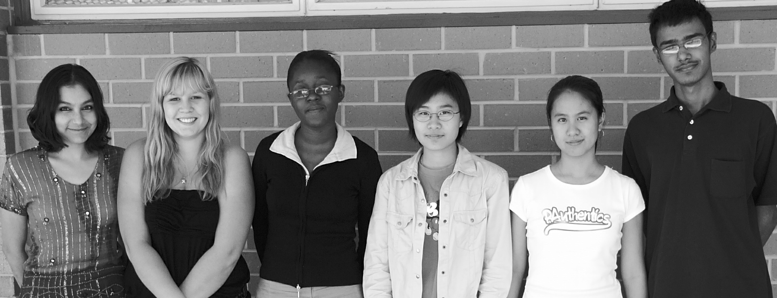
Homo sapiens
Today there is only one human species – Homo sapiens.

